Slide 1

Introduction to GitHub
Zach Muhlbauer
ITP Lab, 3 April 2023
The Graduate Center, CUNY

Slide 2
Intro to GitHub
Contextualize Git and GitHub
Demystify GitHub terminology
Create a GitHub account
Start a project of your own
Contribute to a shared project
Lab Agenda

Slide 3
First, what is git?
Git is the open-source, distributed version control system on which GitHub is based.
open-source = openly licensed software to be reused, remixed, and collaboratively developed
distributed = disseminated and hosted by a decentralized network of collaborators
version control system = keeps an ongoing record of changes to a project for collaborators to review, restore, and implement

Slide 4
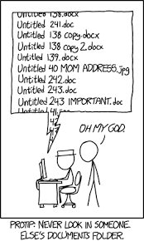
What’s your experience with version control?
Drop some examples in the chat!

Slide 5

So, then, what’s GitHub?
GitHub is a social coding platform designed to serve a variety of purposes:
Hosts open-source projects for you to adopt, share, and build with others
Uses git to track changes to your projects from one version to the next
Enables asynchronous collaboration in transparent, public-facing ways
Serves as a public showcase for your projects and contributions
Allows you to follow the development of open-source projects over time

Slide 6
What do people use GitHub for?
A study of how Digital Humanists use GitHub found that a wide range of users, including professors, research staff, graduate students, IT staff, and librarians used GitHub for a range of activities, including but not limited to:
Developing software
Sharing data sets
Creating websites
Writing articles and books
Keeping research notes
Hosting syllabi and course materials

Slide 7
Let’s have a look for ourselves.
Head to GitHub, search for a project that interests you, then return here to share it in the chat.

Slide 8
GitHub Terminology (is weird…)
GitHub terms can be difficult for beginners to get straight.
So bookmark this glossary:
friendly-github-intro/glossary.md at master
It will come in handy, I promise.

Slide 9
GitHub Term – Repository
What is a repository (or repo)?
Repos can be thought of as a project folder
Contains project files, issues, labels, documentation, & milestones
Stores current and former versions of a project over its full lifespan
Nested under a user or organization

Slide 10
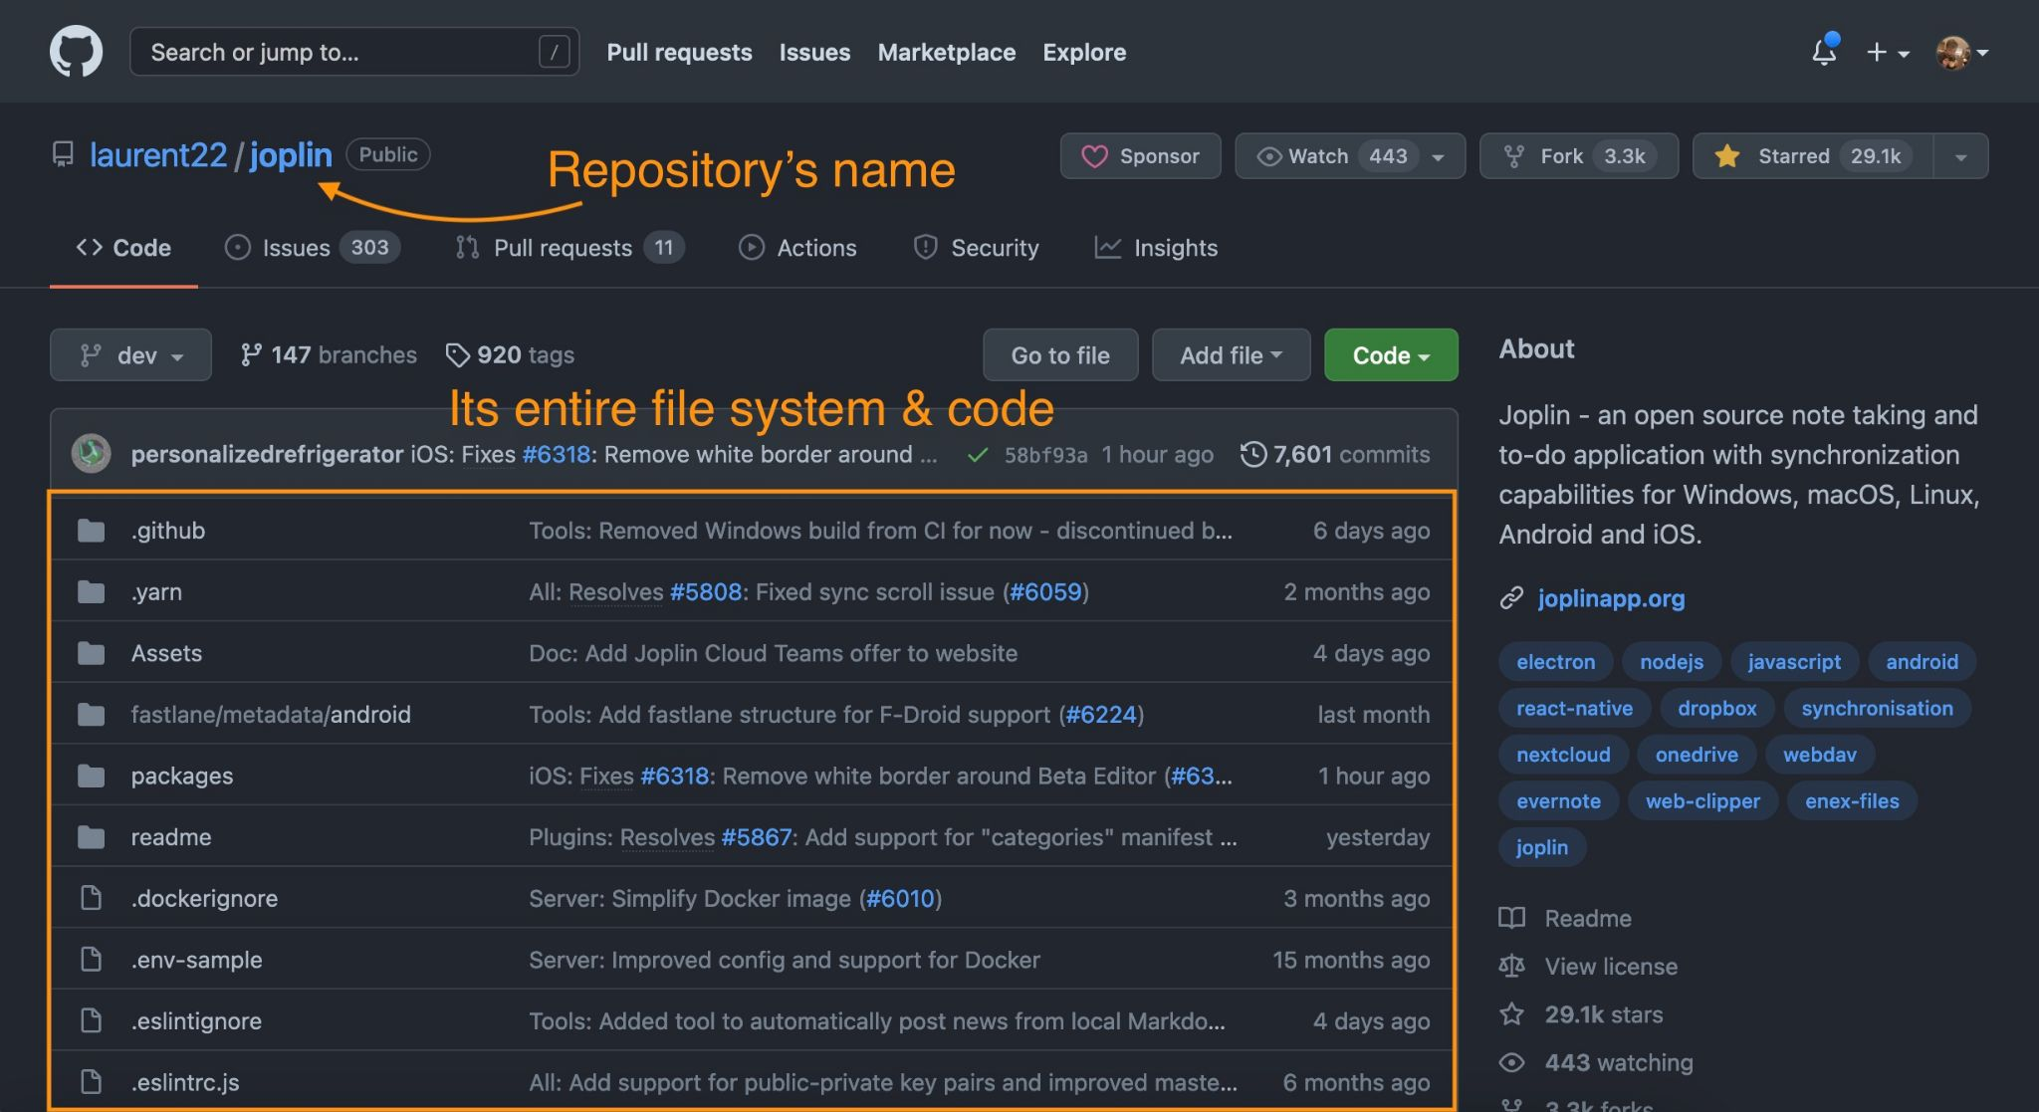

Slide 11
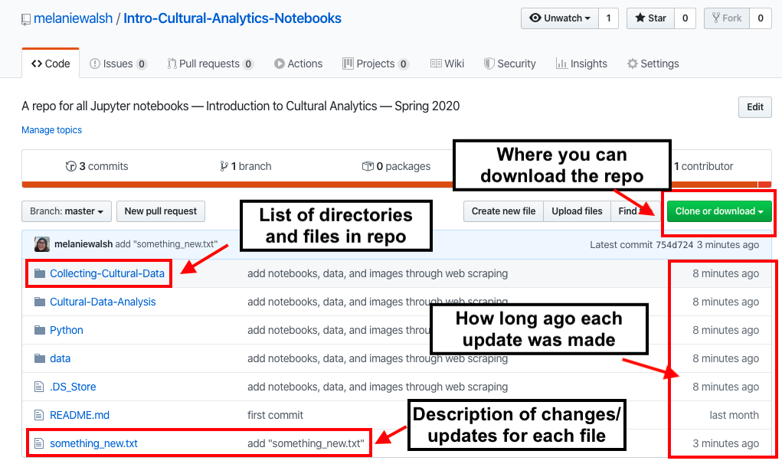
Attribution: Melanie Walsh, https://melaniewalsh.github.io/Intro-Cultural-Analytics/04-Data-Collection/04-Git-GitHub.html.

Slide 12
GitHub Term – Commit
What is a commit? What are some of the ways to commit changes to a repository?
Acts as a way to save or “push” changes to a single file in a repository
Leaves a trail of breadcrumbs as to the development process of a project
Included with a brief description of the changes made to a project
Can commit changes to a project’s main codebase or one of its branches
Alternatively: create a new branch, then start a pull request
Notes:
* A commit is a snapshot of changes made to a repository on GitHub.
* When you make changes to a file or files within a repository on GitHub, you can choose to save those changes as a commit.
* Commits help to keep track of changes made to a repository over time and provide a history of those changes.
* Each commit has a unique identifier called a "SHA" that allows you to reference it later.
* When you make a commit, you can also add a commit message to describe the changes you've made.
* Commits can be viewed and managed through the GitHub interface or through the command line using Git.
* Commits can be pushed to a branch on the repository, allowing you to share your changes with others and collaborate on a project.

Slide 13
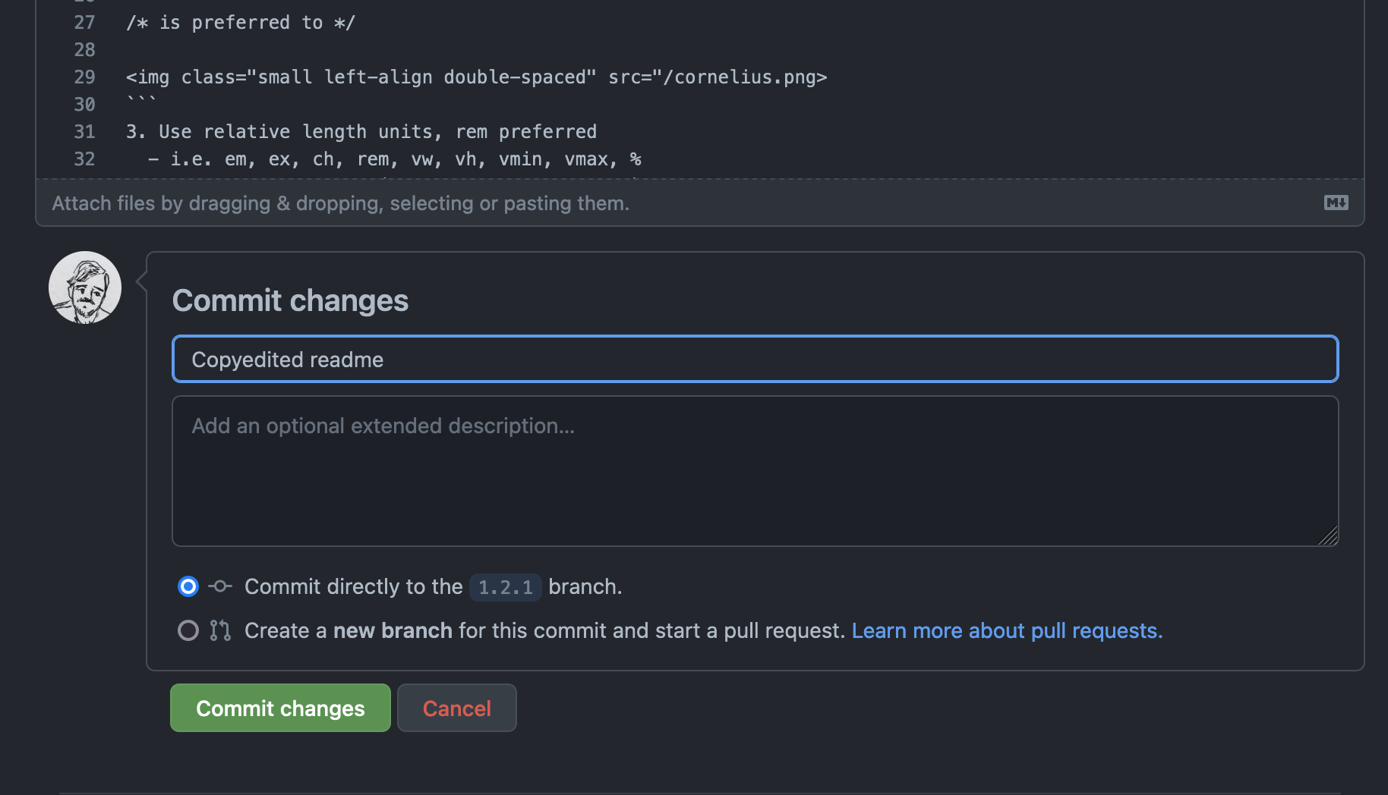

Slide 14
Other GitHub Terms — Branches, Clones, and Forks
Branch:
A way to work on a feature or bugfix without affecting the main codebase
Allows for parallel development by multiple users
Changes can be merged back into the main codebase once stable
Clone:
A copy of a repository on your local machine
Allows you to make changes to the codebase without affecting the original repository
Changes can be pushed back to the original repository if desired
Forks:
A way to make a copy of a repository under your own account
Allows you to experiment with changes without affecting the original repository
Changes can be merged back into the original repository via a pull request

Slide 15
Next up, make your own GitHub account:
https://github.com

Slide 16
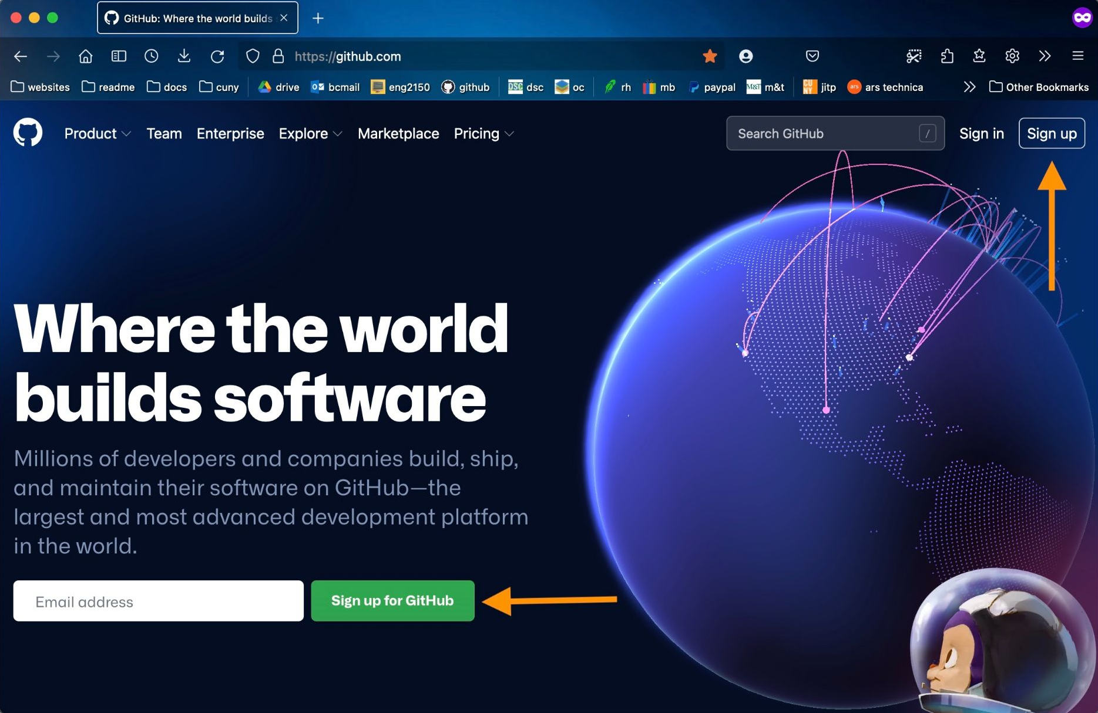
Use the indicated prompts to sign up
When your account is set up & verified, drop a link to it in the chat
If you want, you can use this opportunity to connect with your peers on GitHub
—
Here’s my handle: @zmuhls
https://github.com/zmuhls

Slide 17
Now, create your own repository!
To create a new repository on GitHub:
Click the plus icon next to your username in top-right corner of the site
Give your repository a relevant, succinct name
Write a short description that summarizes its purpose
Select Initialize this repository with a README

Slide 18
README.md
Serves as a title page and abstract for your project
Formatted as a “markdown” file
Explains what your project is meant to do, like a mission statement or overview
What to include in your README.md file
Project’s title
Project description
Table of contents (optional)
How to install and run the project if necessary
How to use the project
Any attributions and credits related to the project
The project’s license

Slide 19
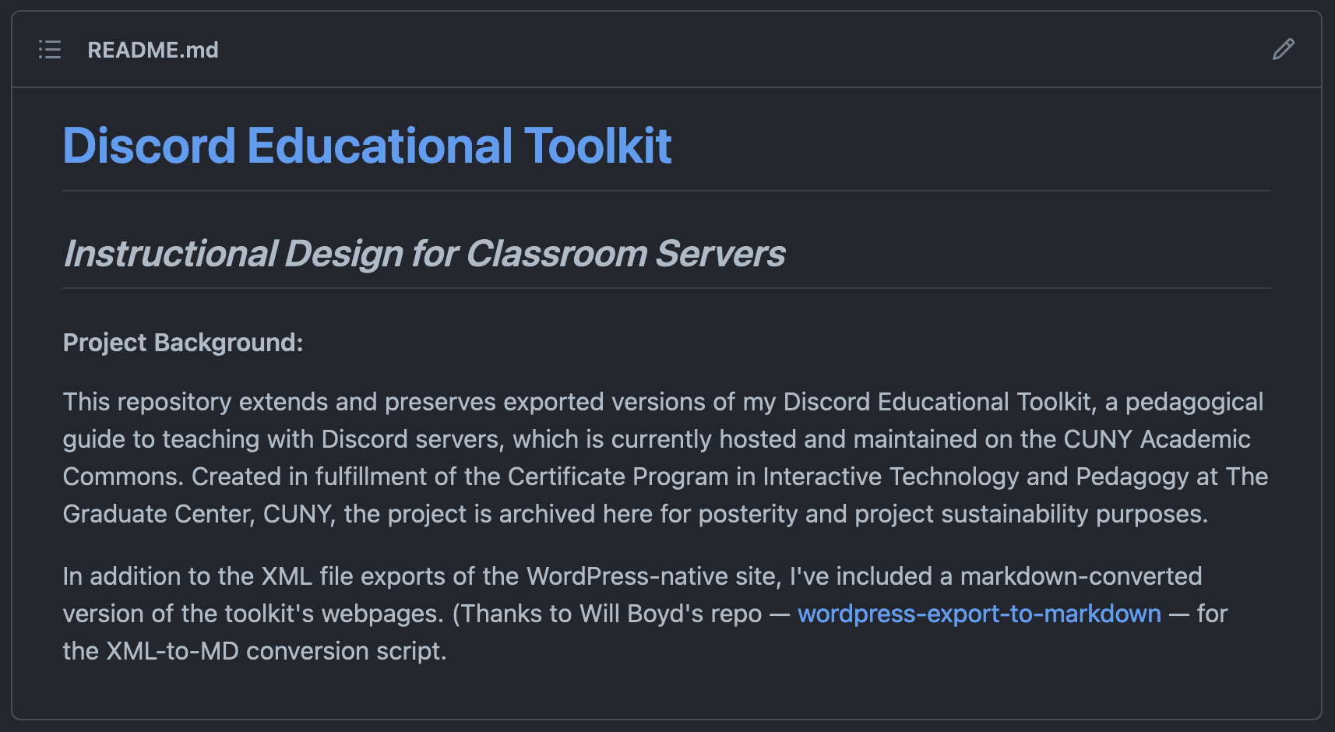

Slide 20
Lastly, contribute to a shared repository
Click the link to this repo to started: https://github.com/zmuhls/exquisite-corpse
Instructions for the collaborative activity are enclosed in the README.md file of the repository.
If a question or issue arises, then don’t hesitate to let me know!

Slide 21

Thanks for participating!
…and see you on GitHub

